Slide 1


Neel Bhadkamkar
25-12-2021

Slide 2
Outline
Executive Summary
Introduction
Methodology
Results
Conclusion
Appendix

Slide 3
Summary of methodologies
Data Collection
Data Wrangling
EDA with Data Visualization
EDA with SQL
Building an interactive map with Folium
Building a Dashboard with Plotly Dash
Predictive analysis (Classification)
Summary of all results
Exploratory data analysis results
Interactive analytics demo in screenshots
Predictive analysis results
Executive Summary

Slide 4

Introduction
We will predict if the Falcon 9 first stage will land successfully. SpaceX advertises Falcon 9 rocket launches on its website with a cost of 62 million dollars; other providers cost upward of 165 million dollars each, much of the savings is because SpaceX can reuse the first stage. Therefore if we can determine if the first stage will land, we can determine the cost of a launch. This information can be used if an alternate company wants to bid against SpaceX for a rocket launch.
Problems that need to be solved-
Factors which influence the rockets successful landing.
The effect of certain rocket variables have on the rocket's successful landing rate.
Conditions to be met to achieve the best results and to ensure the best successful landing rate.

Slide 5

METHODOLOGY

Slide 6
Methodology
Executive Summary
Data collection methodology:
SpaceX REST API
Web Scraping from Wikipedia
Performed data wrangling
One Hot Encoding was done on landing outcome column.
Performed exploratory data analysis (EDA) using visualization and SQL
Performed interactive visual analytics using Folium and Plotly Dash
Performed predictive analysis using classification models
How to build, tune, evaluate classification models

Slide 7

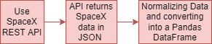

Data Collection
The Datasets were obtained by-
SpaceX Launch Data was gathered from the SpaceX REST API.
The API provided launch data including the rocket used, payload delivered, launch specifications and landing outcomes.
The SpaceX Rest API endpoints all start with https://api.spacexdata.com/v4/ .
Another data source for obtaining Falcon 9 data is web scraping the Wikipedia Page Titled 'List of Falcon 9 and Falcon Heavy Launches' using BeautifulSoup.
SpaceX API
Web Scrapping

Slide 8
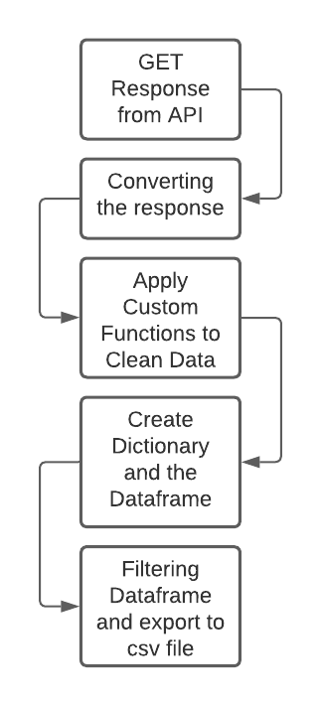
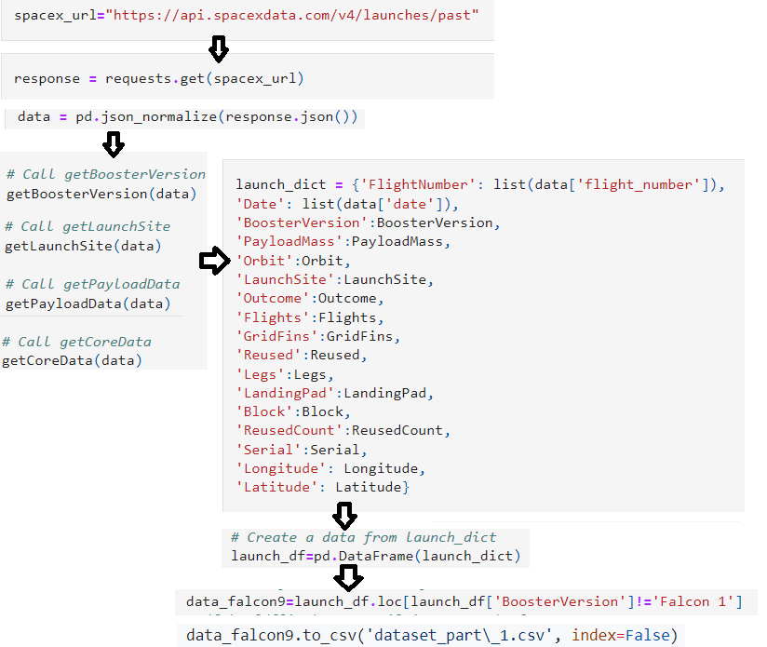
Data Collection – SpaceX API
GitHub Notebook URL

Slide 9
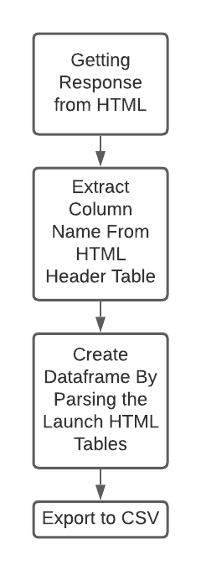
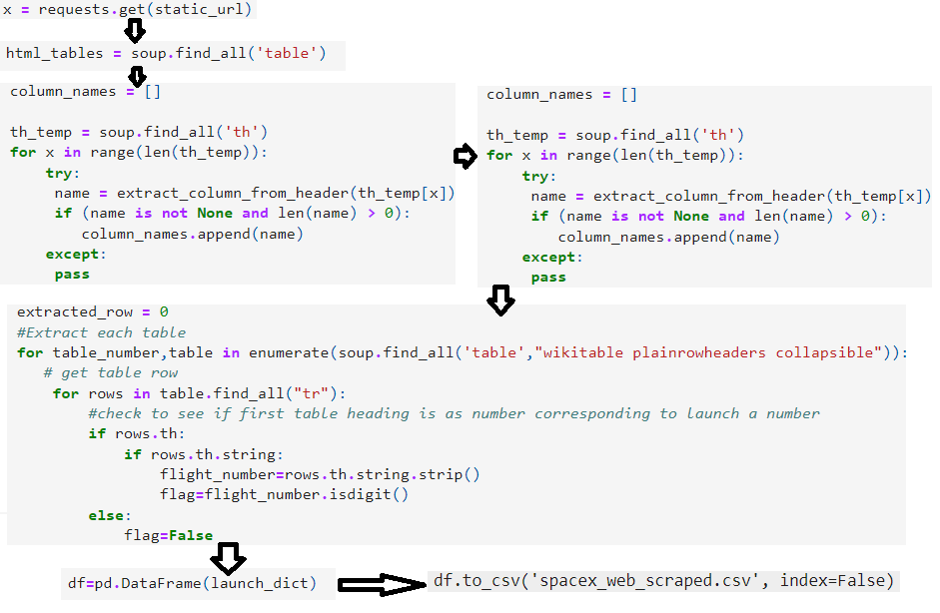
Data Collection - Scraping
Notebook Link

Slide 10
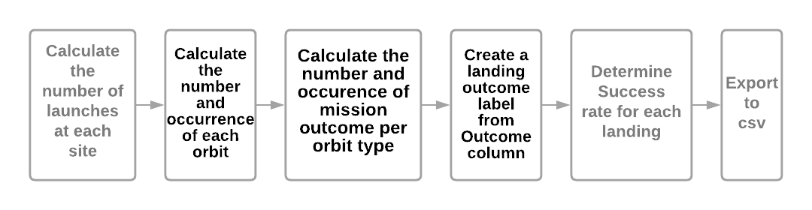
DATA WRANGLING
Introduction
In the data set, there are several different cases where the booster did not land successfully. Sometimes a landing was attempted but failed due to an accident; for example, True Ocean means the mission outcome was successfully landed to a specific region of the ocean while False Ocean means the mission outcome was unsuccessfully landed to a specific region of the ocean. True RTLS means the mission outcome was successfully landed to a ground pad False RTLS means the mission outcome was unsuccessfully landed to a ground pad.True ASDS means the mission outcome was successfully landed on a drone ship False ASDS means the mission outcome was unsuccessfully landed on a drone ship. We will mainly convert those outcomes into Training Labels with 1 means the booster successfully landed 0 means it was unsuccessful.
Notebook Link

Slide 11

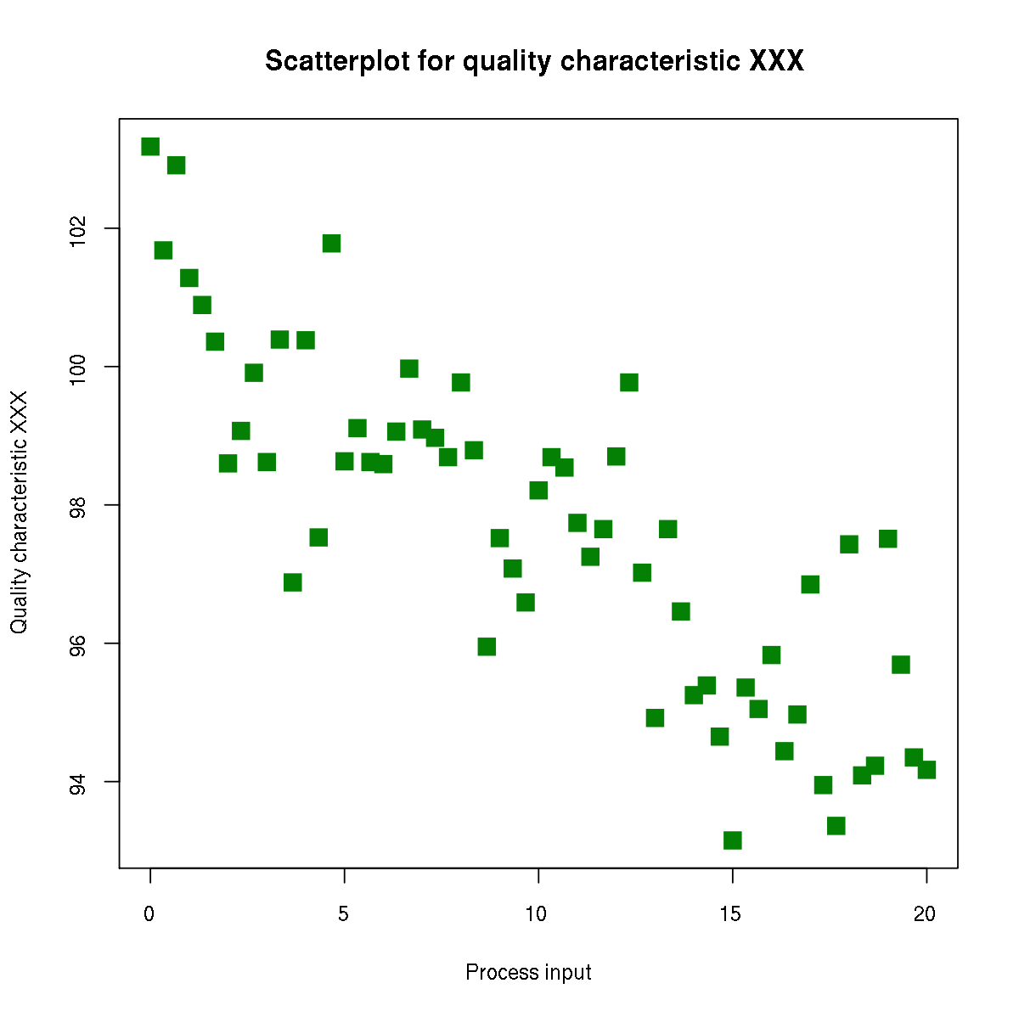
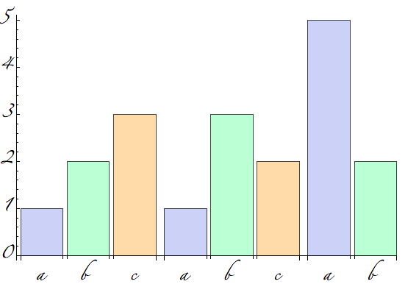

EDA with Data Visualization
Scatter Point Plot:
Flight V/S Payload Mass
Payload V/S Launch Site
Orbit V/S Flight Number
Payload V/S Orbit Type
Orbit V/S Payload Mass
Scatter Plots show how much a variable is correlated to another.
Bar Graph
Mean V/S Orbit
A bar chart or bar graph is a chart or graph that presents categorical data with rectangular bars with heights or lengths proportional to the values that they represent.
Line Graph
Success Rate V/S Year
Line graphs (or line charts) are best when you want to show how the value of something changes over time, or compare how several things change over time relative to each other.
Notebook URL

Slide 12


EDA with SQL
Used SQL queries to gather information from the dataset.
Examples of queries performed on the dataset-
Display the names of the unique launch sites in the space mission
Display 5 records where launch sites begin with the string 'CCA'
Display the total payload mass carried by boosters launched by NASA (CRS)
Display average payload mass carried by booster version F9 v1.1
List the date when the first successful landing outcome in ground pad was acheived.
List the names of the boosters which have success in drone ship and have payload mass greater than 4000 but less than 6000
List the total number of successful and failure mission outcomes
List the names of the booster_versions which have carried the maximum payload mass. Use a subquery
List the failed landing_outcomes in drone ship, their booster versions, and launch site names for in year 2015
Rank the count of landing outcomes (such as Failure (drone ship) or Success (ground pad)) between the date 2010-06-04 and 2017-03-20, in descending order
GitHub Notebook URL

Slide 13
Build an Interactive Map with Folium
We marked and labelled each launch site with CircleMarker using the latitude and longitude coordinates.
We marked the success and failure for each site using Green and Red Markers for success and failure respectively. This was done using MarkerCluster().
Calculation of the Distance from Launch Site to various landmarks was done to gain insight on the Launch Site location.
With them we were able to answer the following questions -
Are launch sites in close proximity to railways? No
Are launch sites in close proximity to highways? No
Are launch sites in close proximity to coastline? Yes
Do launch sites keep certain distance away from cities? Yes
Notebook URL

Slide 14

Build a Dashboard with Plotly Dash
An interactive Dashboard was created using the Dash and Flask Web Framework. It's was also deployed on heroku so that it can be accessed 24/7.
Dropdown List, slider, functions to display pie chart and scatter plot were added to the Dashboard.
Pie Chart-
Pie Chart shows the total launches for all sites.
It represents data visually as a fractional part of a whole, which can be an effective communication tool for the even uninformed audience.
It enables the audience to see a data comparison at a glance to make an immediate analysis or to understand information quickly.
Scatter Plot-
It is used to see the relation between two variables.
Using it we can deduce the relation between the variables be it – strong or weak, linear or non-linear, positive or negative.
In this dashboard we have plotted to show the relation between payload mass (kg) and Outcome for the different Booster Versions.
Website Link (Heroku)
Github Notebook Link

Slide 15

Predictive Analysis (Classification)
Building the Model
Loading the dataset and creating a pandas dataframe.
Transform the data using numpy library.
Split the dataset into training and testing data.
Select machine learning algorithms we want to use.
Select the algorithm and parameters and pass it to the GridSearchCV function.
Fit the model to the training dataset.
Evaluate the Model
Check accuracy for each model
Plot Confusion Matrix
Find The Best Performing Classification Model
The best performing model is the one with the highest accuracy score.
Github Notebook Link

Slide 16
Results
Exploratory data analysis results
Interactive analytics demo in screenshots
Predictive analysis results

Slide 17


Slide 18

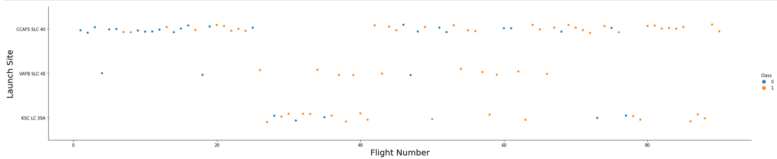
Flight Number vs. Launch Site
Graph suggests an increase in success rate over time. Most likely a big breakthrough occurring around flight number 20 which significantly increased success rate. CCAFS seems to be the primary launch site as it has the highest number of launches.

Slide 19
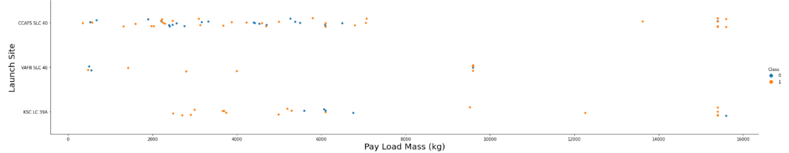
Payload vs. Launch Site
Payload mass appears to fall mostly between 0-6000 kg.
For Launch Site CCAFS SLC 40 the higher payload mass launches have highest success rate.

Slide 20
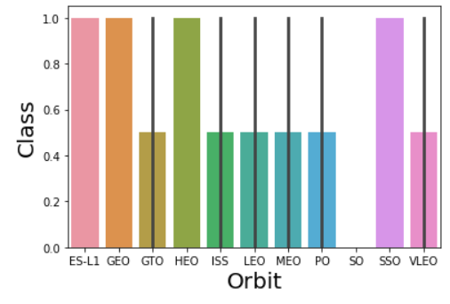
Success Rate vs. Orbit Type
ES-L1. GEO, HEO, SSO have the highest success rate of 100%.
SO has the success rate of 0%.

Slide 21
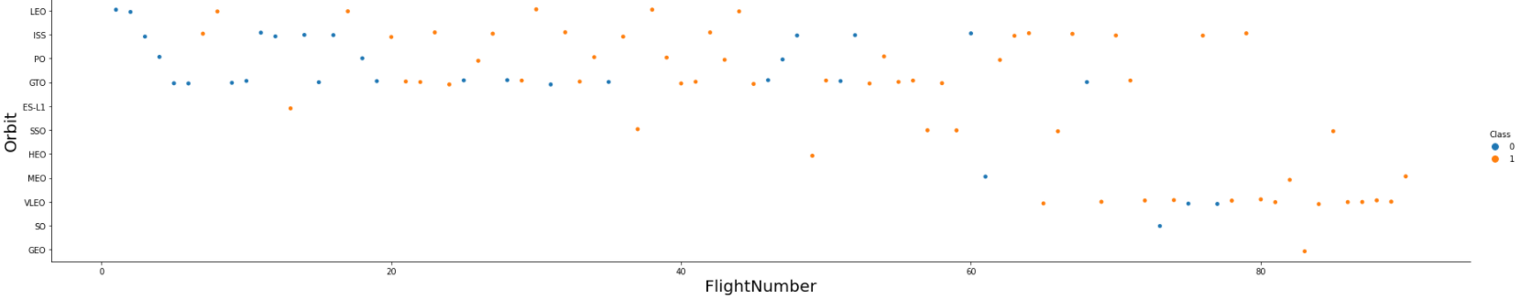
Flight Number vs. Orbit Type
We can see that in the LEO orbit the Success appears related to the number of flights; on the other hand, there seems to be no relationship between flight number when in GTO orbit.

Slide 22
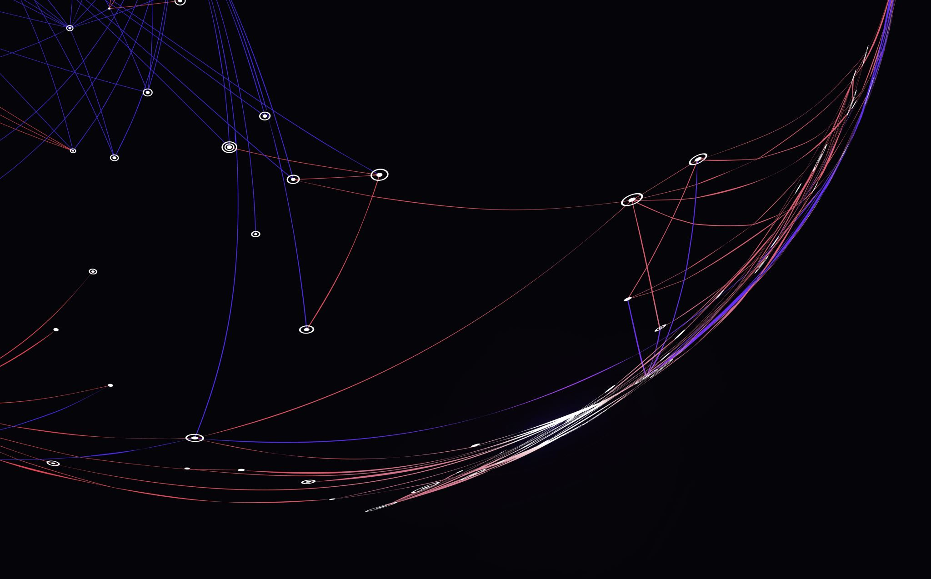
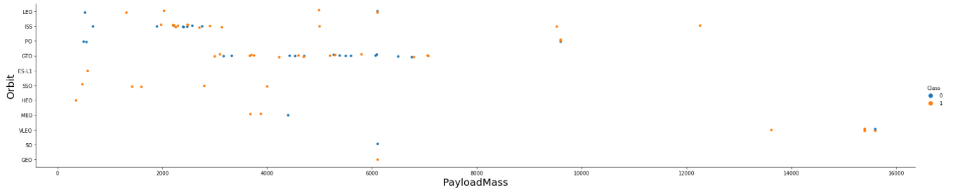
Payload vs. Orbit Type
Here we observe that Heavy payloads have a negative influence on GTO orbits and positive on GTO and Polar LEO (ISS) orbits.

Slide 23
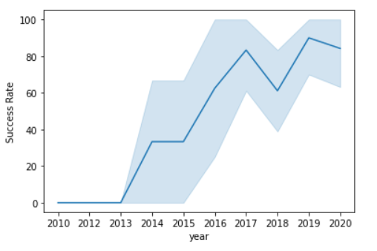
Launch Success Yearly Trend
We can observe that the sucess rate since 2013 kept increasing till 2020

Slide 24

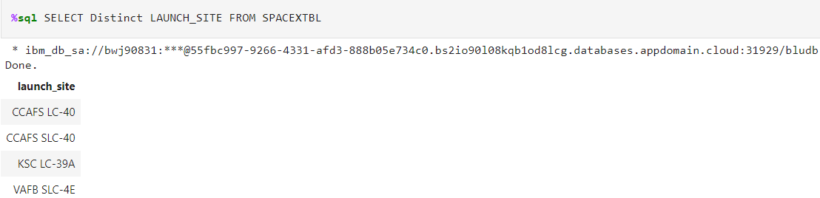
All Launch Site Names
Distinct Keyword is used to show all unique values in Launch_Site Column.

Slide 25
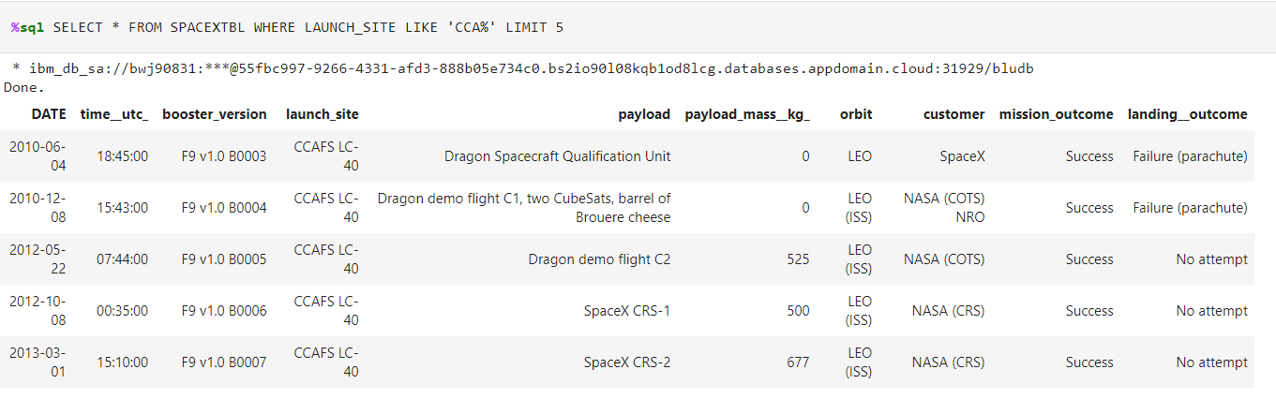
Launch Site Names Begin with 'CCA'
Limit 5 shows the first 5 results. LIKE 'CCA%' is used to get the launch site names starting with CCA

Slide 26

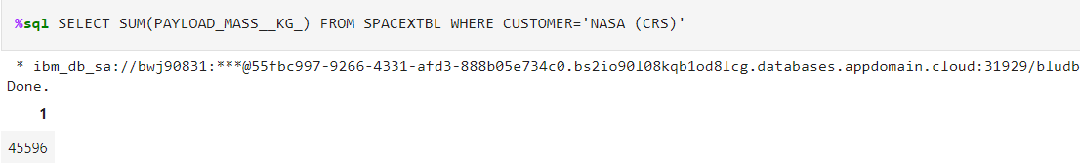
Total Payload Mass
Sum is used to the total payload mass. WHERE clause is used to so that the query only performs calculations when the customer is NASA (CRS)

Slide 27
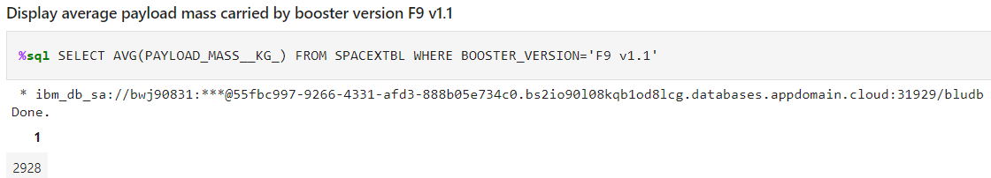
Average Payload Mass by F9 v1.1
Here AVG function is used to get the average of the column PAYLOAD_MASS_KG
WHERE clause is used to only perform calculations on the booster version F9 v1.1 entries.

Slide 28
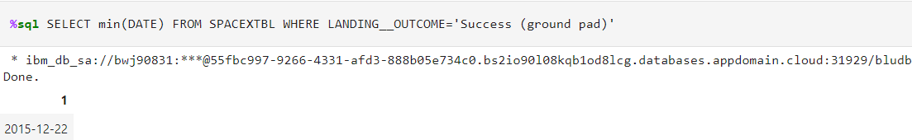
First Successful Ground Landing Date
MIN function fetches the minimum date in the column Date
WHERE clause is used to only include successful landing outcomes (Ground Landing)

Slide 29
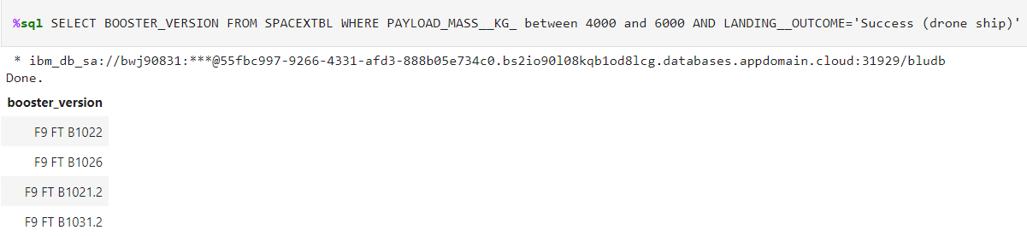
Successful Drone Ship Landing with Payload between 4000 and 6000
The Results are-
F9 FT B1022
F9 FT B1026
F9 FT B1021.2
F9 FT B1031.2
Between 4000 and 6000 is used to only display successful landings with payload in range 4000-6000

Slide 30
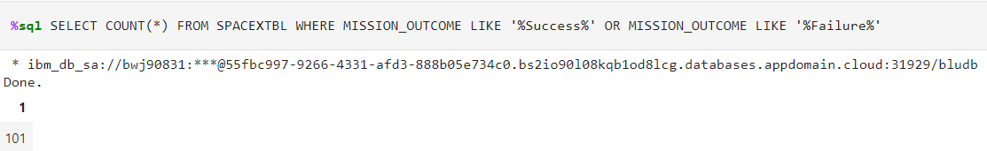
Total Number of Successful and Failure Mission Outcomes
Count function is used to get the count of the landings.
We can see that the total number of successful and failed missions are 101.

Slide 31
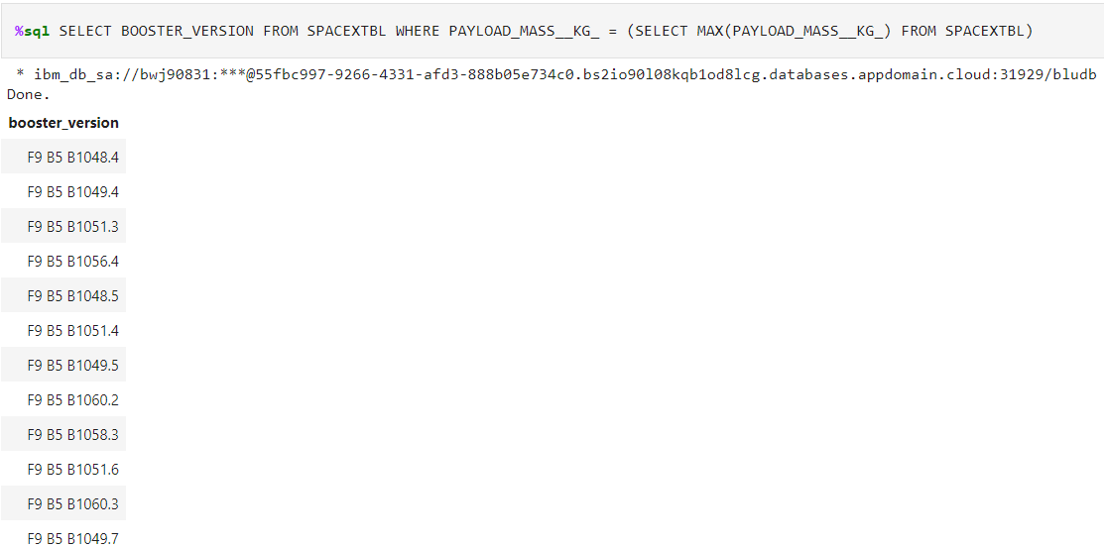
Boosters Carried Maximum Payload
Max Function is used in the subquery to get the booster version with the highest payload mass.

Slide 32
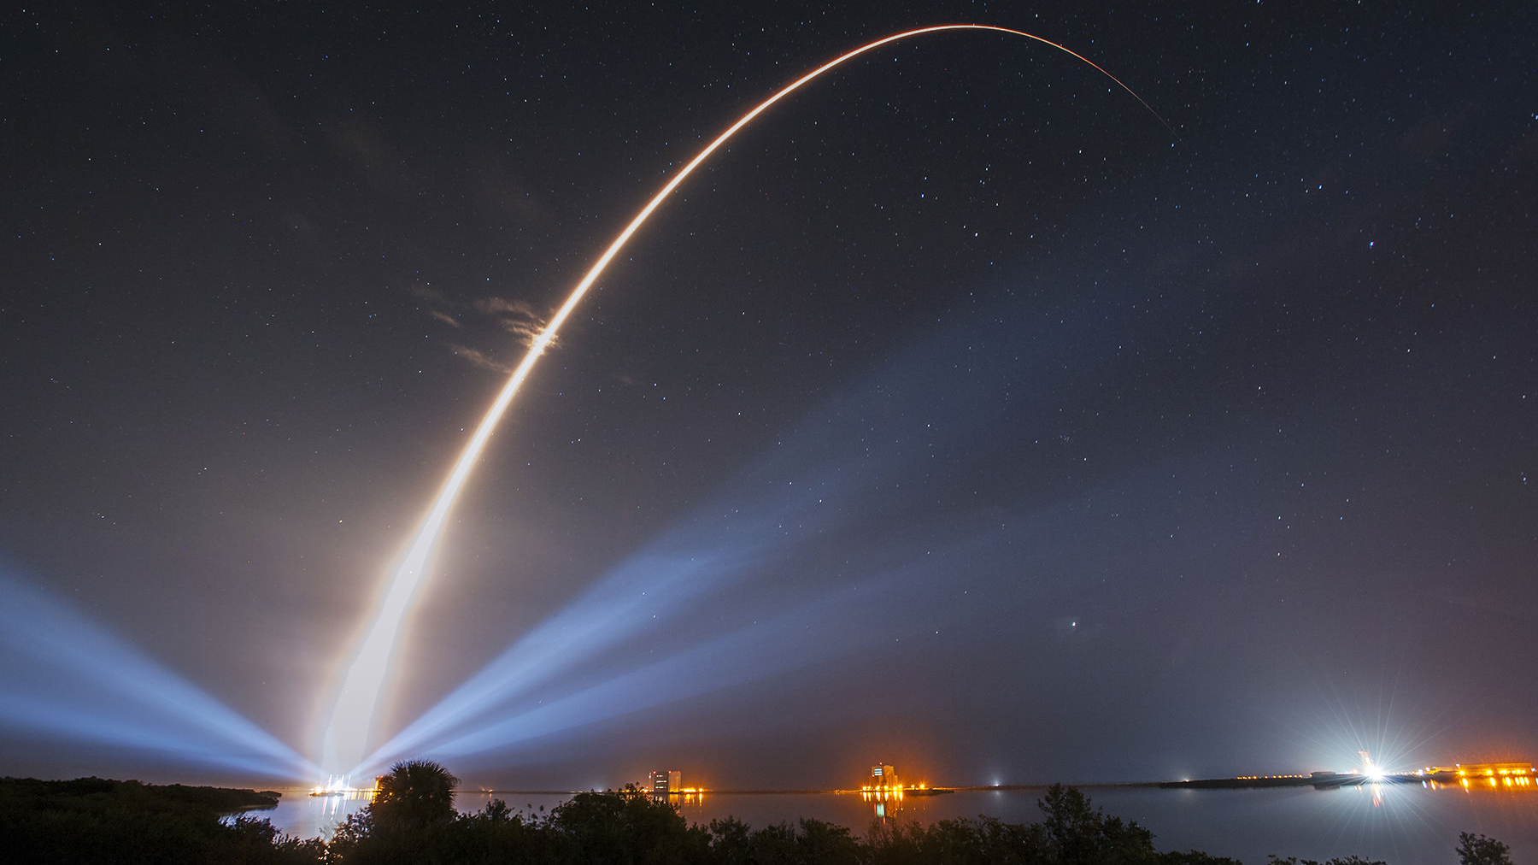
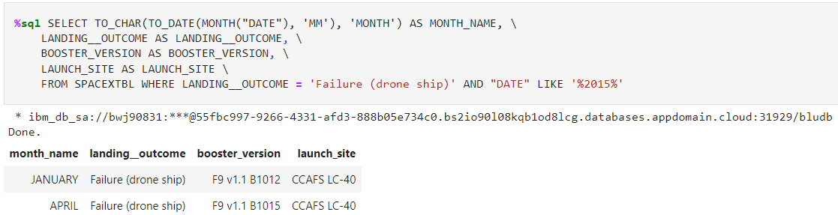
2015 Launch Records
The failed launch outcomes in the year 2015 are -
F9 v1.1 B1012
F9 v1.1 B1015

Slide 33
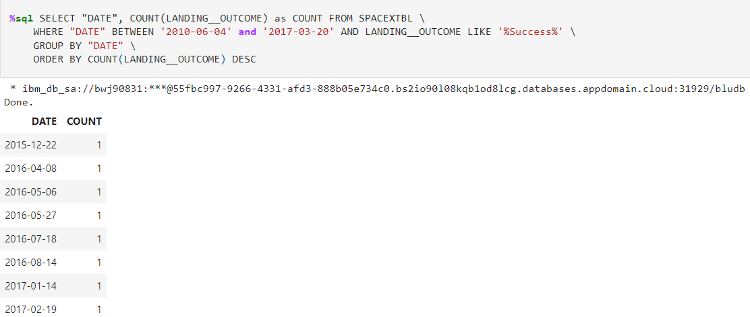
Rank Landing Outcomes Between 2010-06-04 and 2017-03-20
Function Count counts the records in the column, WHERE clause is used to filter the records
Desc Orders the Count of Landing Outcomes in descending order.

Slide 34


Slide 35

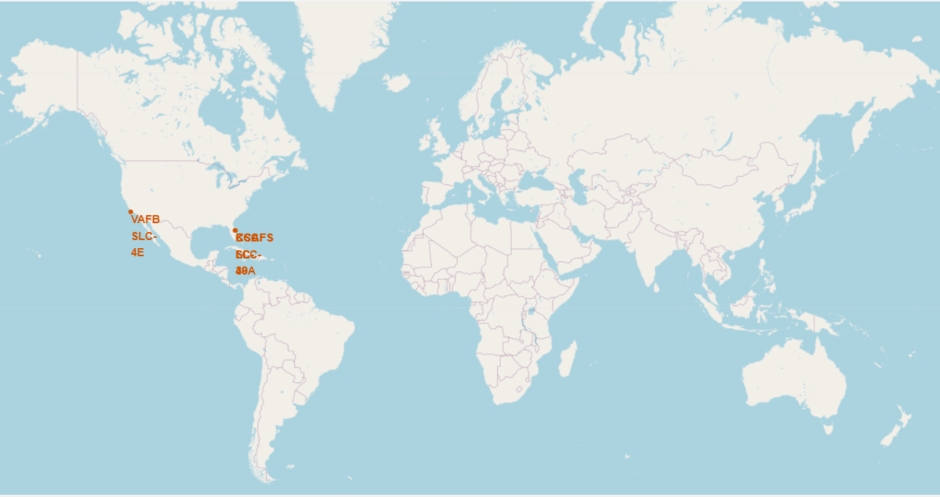
Launch Site GLOBAL MARKERS
We can see that the launch sites are on the east and the west coasts of USA.

Slide 36

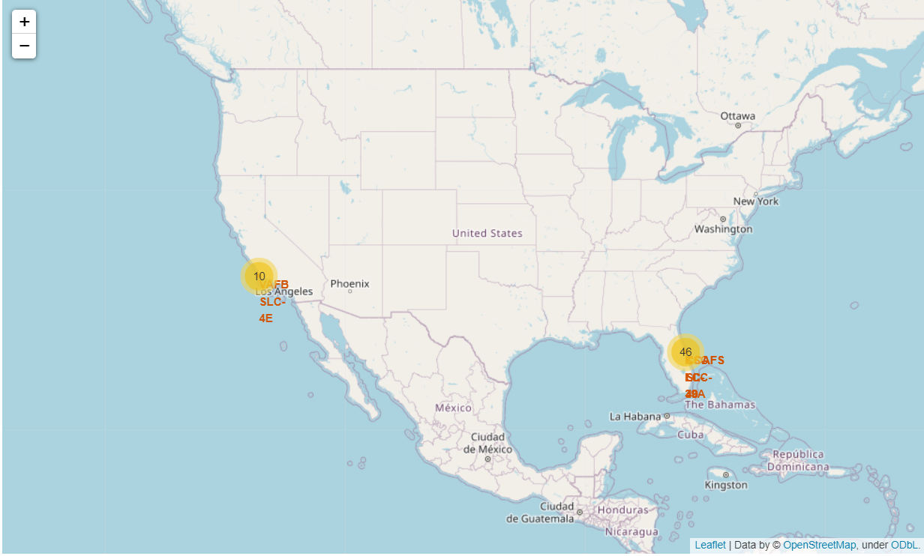
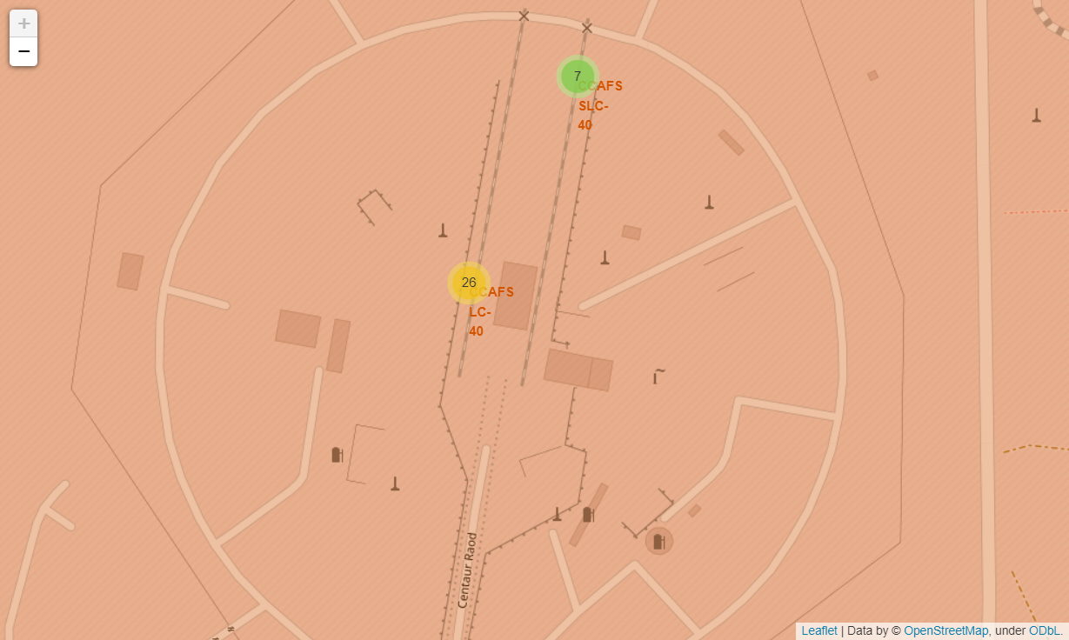
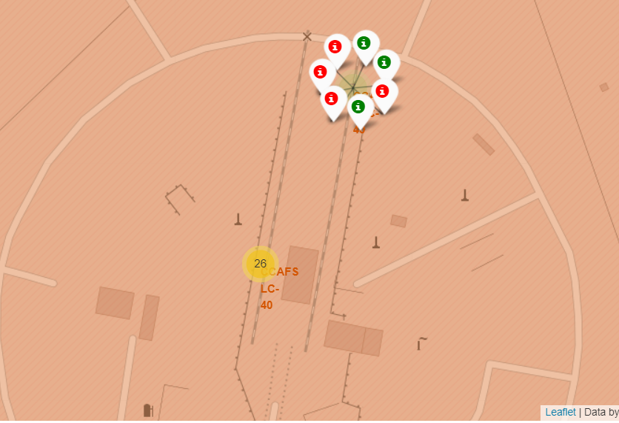
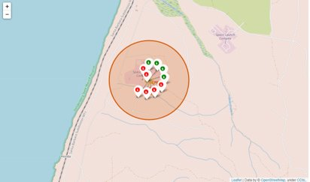
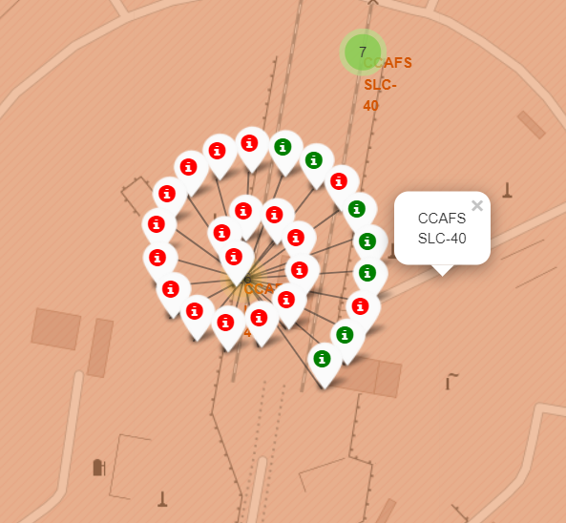
Launch Outcomes Colored Markers
The Cluster Markers in folium can be clicked to reveal green and red markers to show successful and failed landing outcomes respectively.

Slide 37
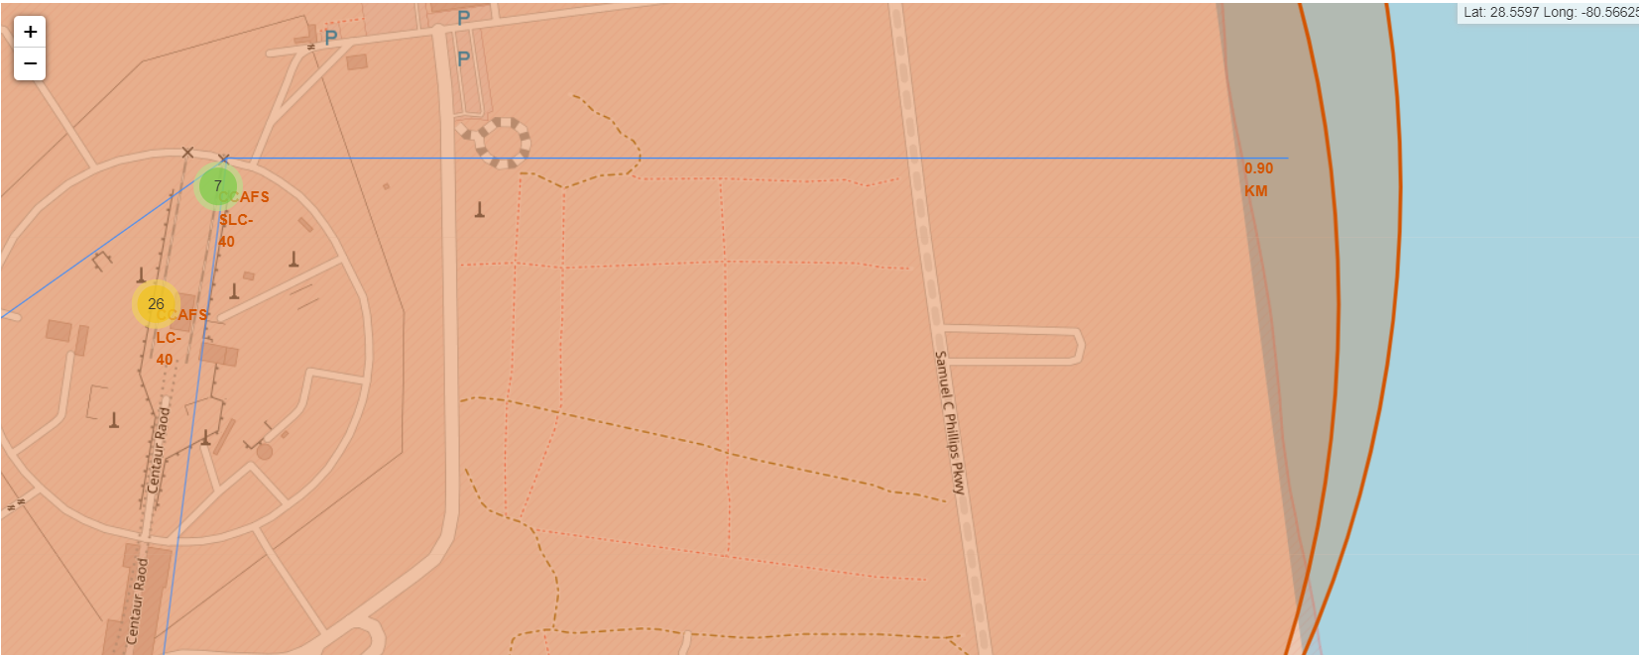
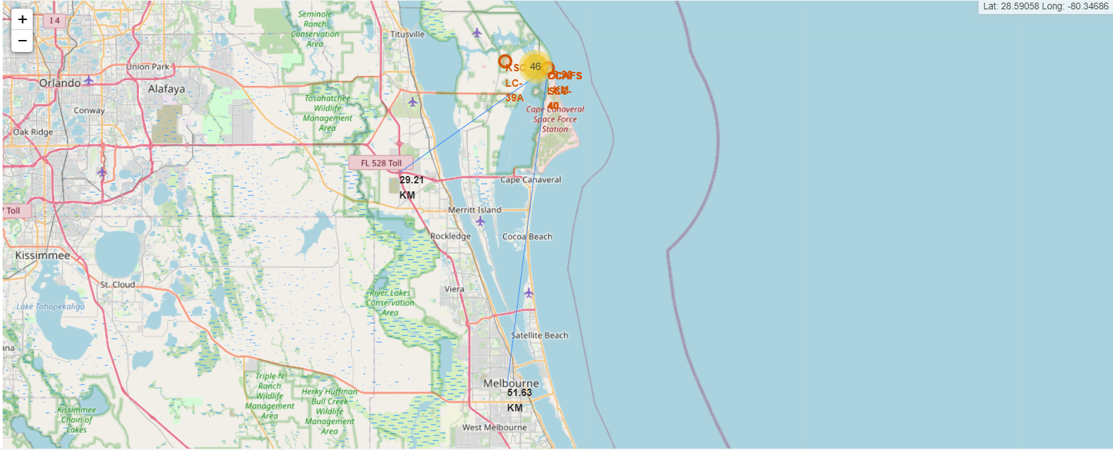
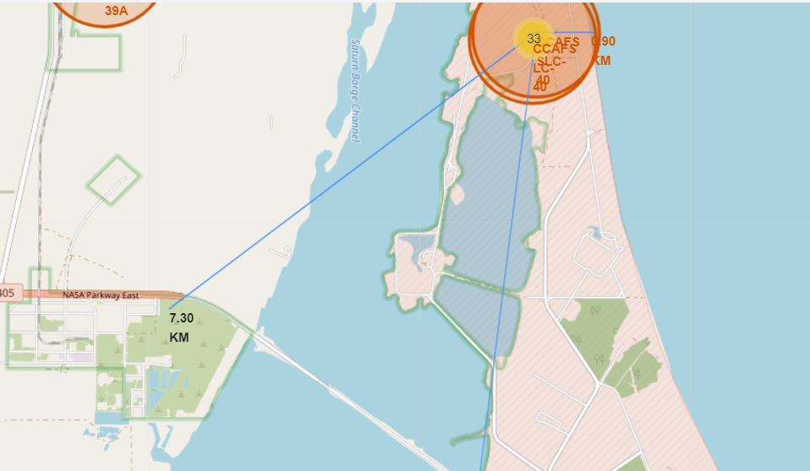
Key Locations Proximities
Launch sites are close to highways and coast for transportation and supply. They're also far away from cities in order to mitigate risk to bystanders should a rocket experience a catastrophic failure.

Slide 38


Slide 39
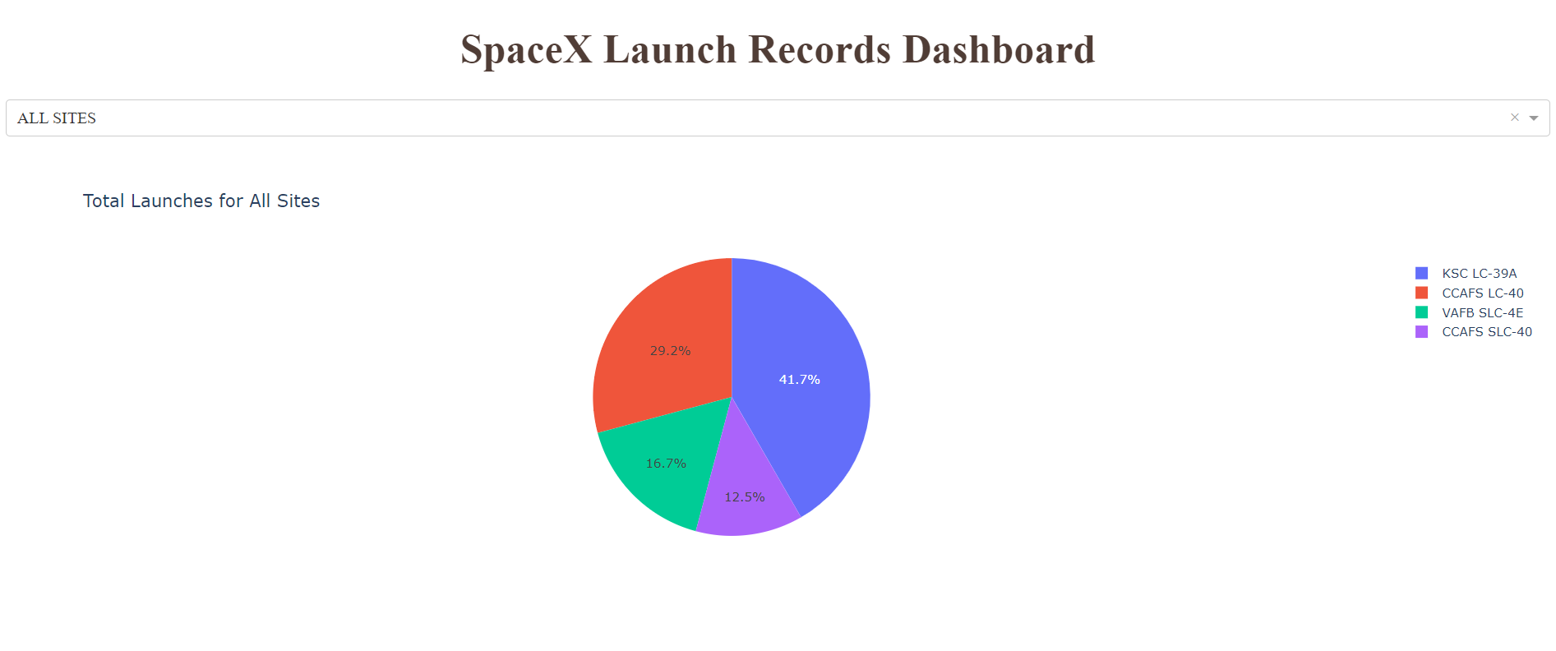
SpaceX Successful Launches
We can observe that KSC LC-39A has the most successful launches followed by CCAFS LC-40 and VAFB SLC-4E.CCAFS SLC-40 has the least number of successful launches.

Slide 40
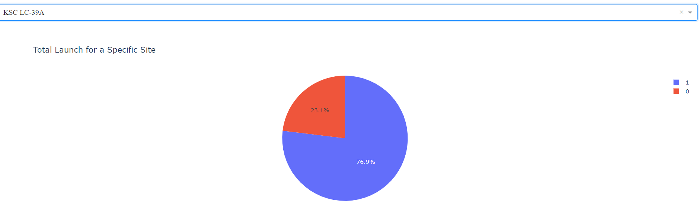
Launch site with highest success
KSC LC-39A has success rate of 76.9% and failure rate of 23.1%.

Slide 41
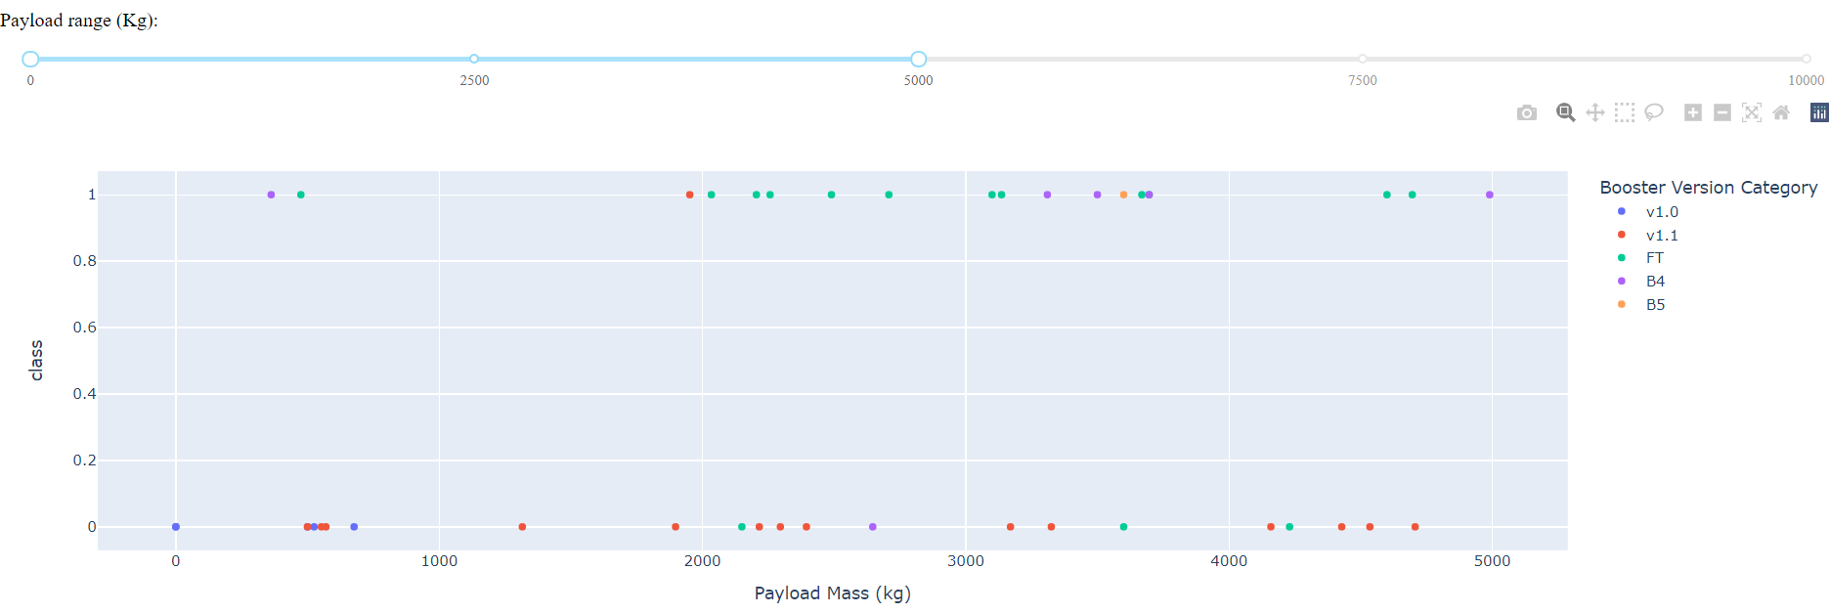
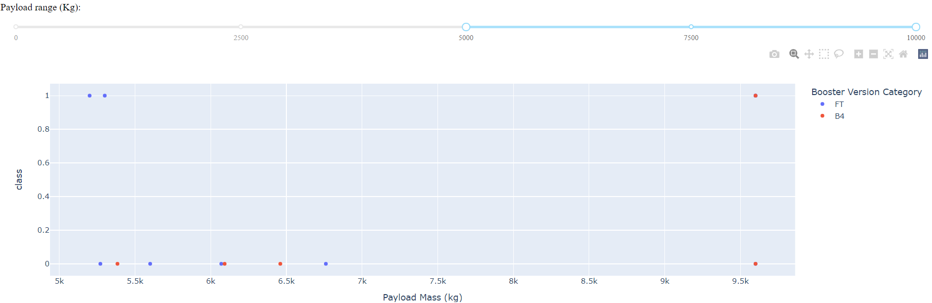
Success Payload Plot
We can observe that the success rate of payload 0-5000 kg range is higher than the success rate of the 5000-10000 kg range.

Slide 42


Slide 43
Classification Accuracy
KNN, Logistic Regression, SVM Have the same accuracy of 0.8333
Decision Tree Model has the accuracy of 0.7222 on the test dataset

Slide 44
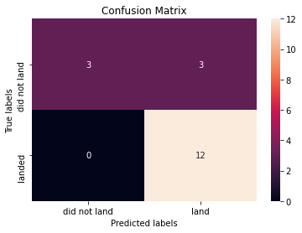
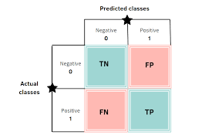
Confusion Matrix
The confusion matrix for the KNN model has 3 false positives, shows us that three of the landings predicted by the model as success were in fact failures.

Slide 45
Conclusions
We trained a KNN Model with an accuracy of 83.33% to predict the landing success rate for the launches for different launch sites and payloads. This is the best performing model.
We observe that the launches from the launch site KSC LC-39A had the most success rate.
We also observe that the lower payload launches have higher success rate than their heavier load counterpart.
Orbits GEO,HEO,SSO,ES-L1 have the highest success rate for the launches.
Thus We have thus used our data-driven insights to determine if the first stage of Falcon 9 will land successfully.

Slide 46
Appendix
GitHub Repository : https://github.com/Neel-XV/IBM-Data-Science/tree/master
Dashboard On Heroku : http://coursera-dash.herokuapp.com/

Slide 47


